Slide 1
Marketing And Retail Analysis PROJECT MODULE - I
NAME : SHOUNACK MANDAL
COURSE: PGP - DSBA Online Sep.
Date: 19/ June / 2022

Slide 2
Contents of the presentation
Problem Statement
Agenda & Executive Summary of the data
Exploratory Analysis and Inferences
Customer Segmentation using RFM analysis (make 4 segments)
Inferences from RFM Analysis and identified segments

Slide 3
Problem statement
This project aims to find the underlying buying patterns of the customers of an automobile part manufacturer based on the past 3 years of the Company's transaction data and hence recommend customized marketing strategies for different segments of customers.

Slide 4
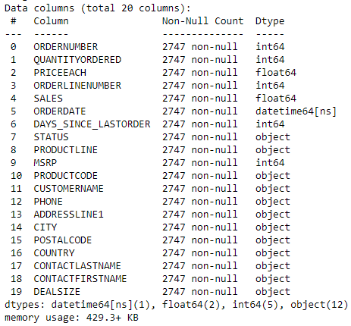
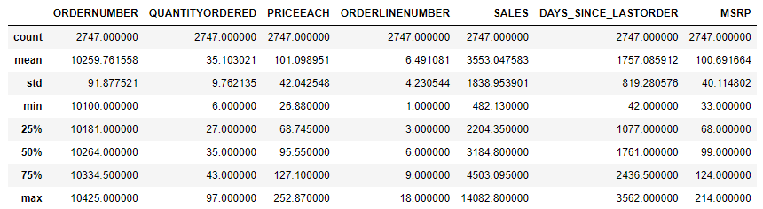
About Data - (Info, Shape, Summary Stats, your assumptions about data)
ASSUMPTIONS:-
There are no Null values in data and even no duplicate values.
Country would represent the order grographical information( In the data we have maximum collated information for USA ).
Also we can drop city, address1, phone number, customername and others since they are not required for the analysis.
Shape of the data is 2747 rows and 20 columns.

Slide 5
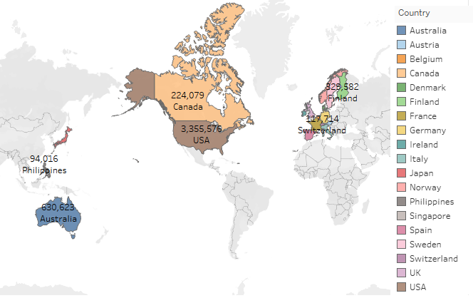
Country wise sales :-

Slide 6
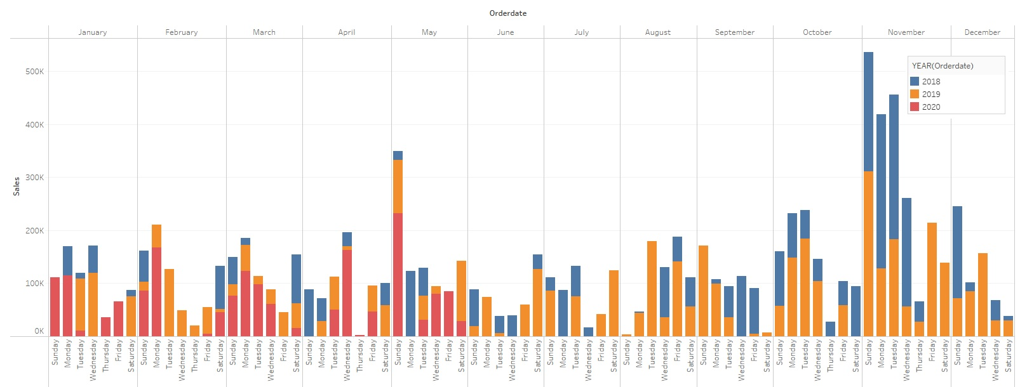
Exploratory Analysis and Inferences
Univariate, Bivariate, and multivariate analysis using data visualization
Weekly, Monthly, Quarterly, Yearly Trends in Sales with orderdate

Slide 7
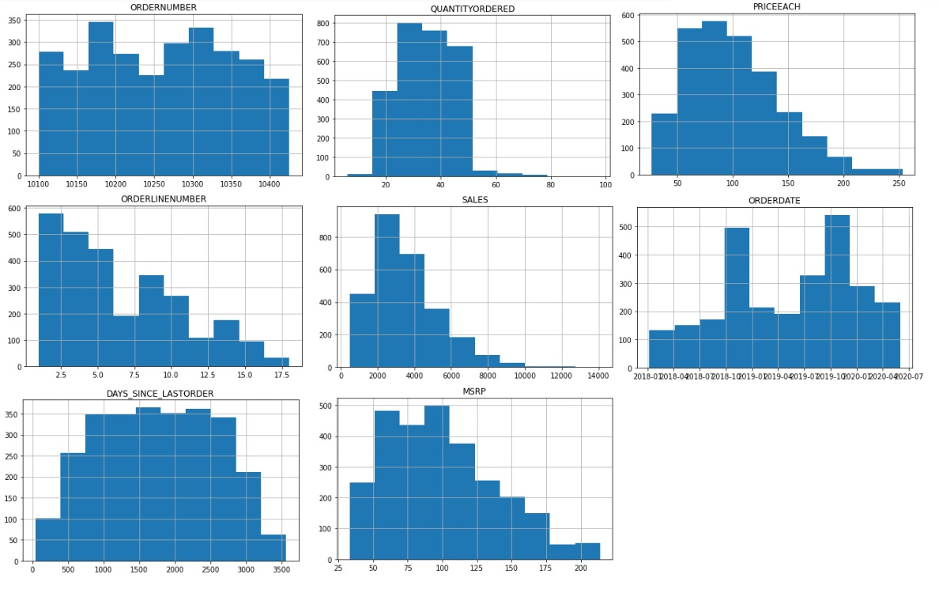
Univariate for all the measures in the data

Slide 8
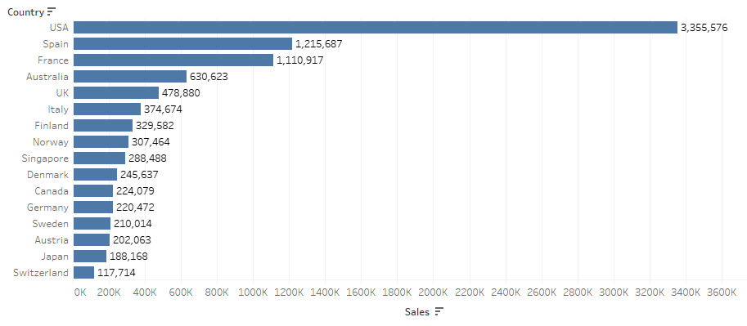
Exploratory Analysis and Inferences
Univariate, Bivariate, and multivariate analysis using data visualization
Sales Across different Categories of different features in the given data.

Slide 9
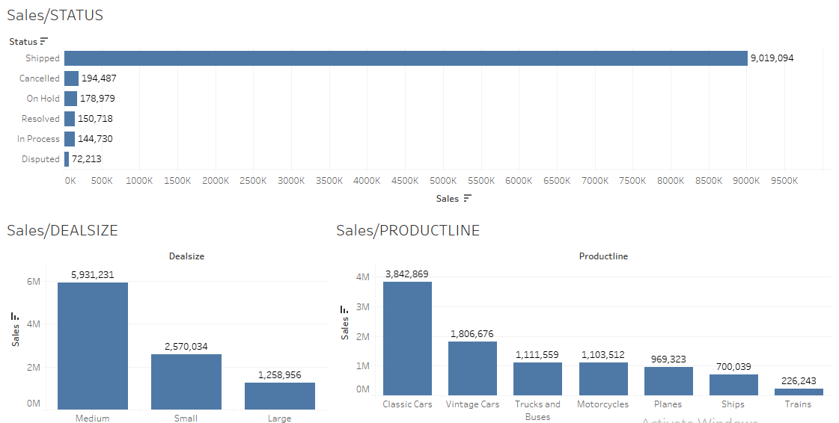
Exploratory Analysis and Inferences
Sales Across different Categories of different features in the given data.

Slide 10
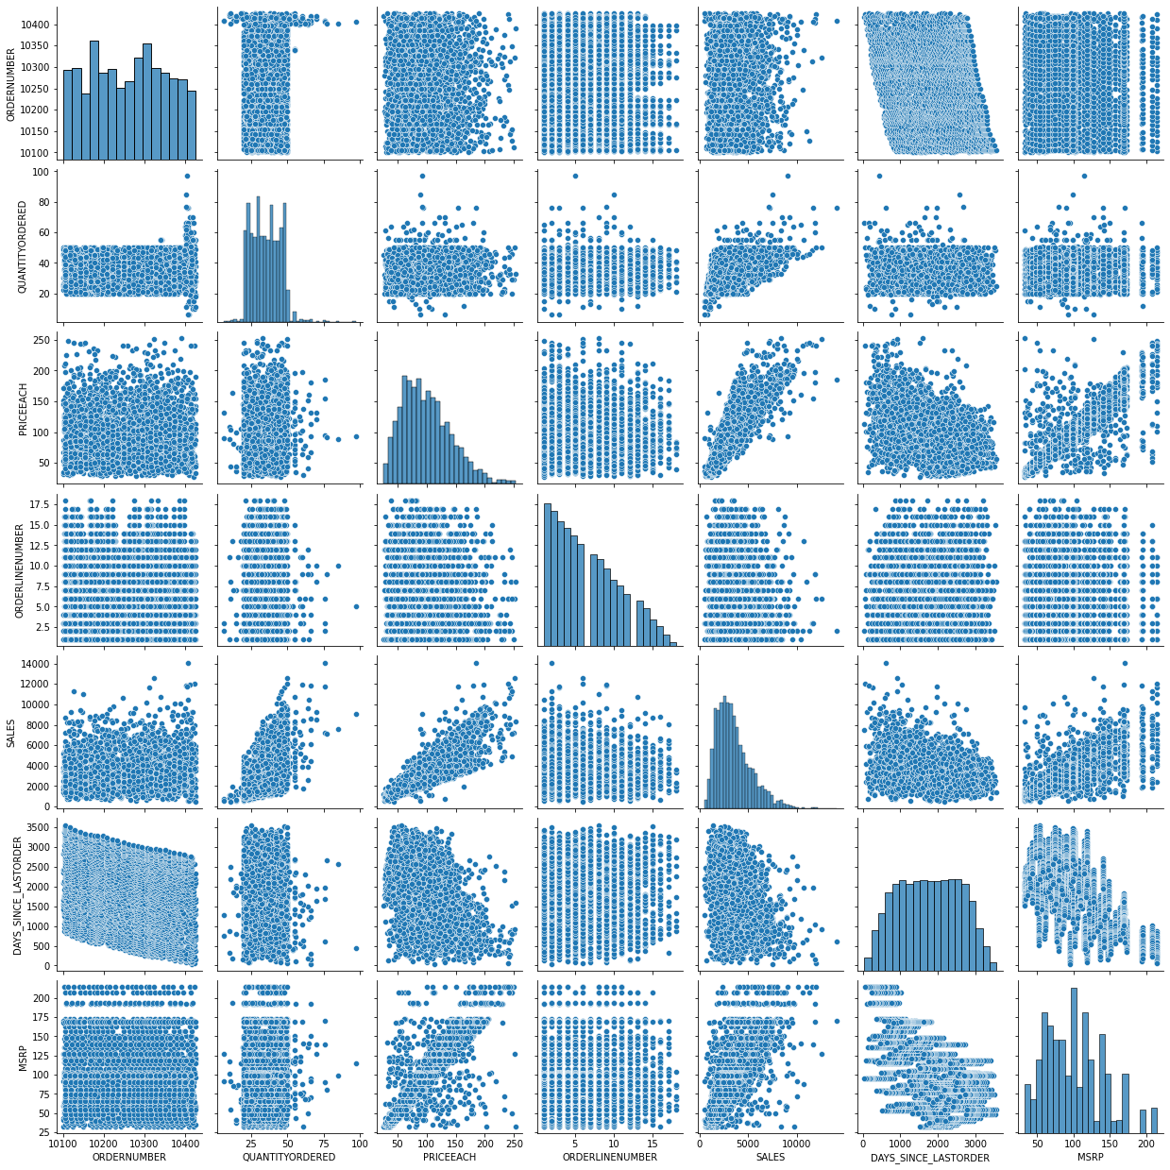
MULTIVARIATE ANALASYS OF ALL THE MEASURES

Slide 11
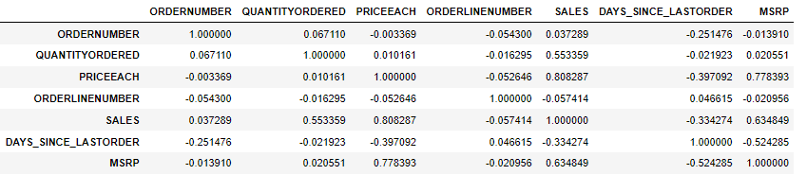
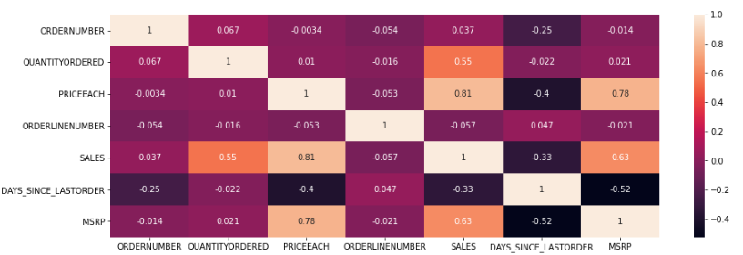
MULTIVARIATE ANALASYS – CORRELATION AND HEAT MAP

Slide 12
Exploratory Analysis and Inferences
Summarize the inferences from the above analysis
Sales and Priceeach are highly positively collerated with coeffiecient of correlation=.81,priceeach and MSRP are poistively correlated (0.78) followed by sales and priceeach (0.63). Sales and order quantity shows a correlation of 0.55.
Maximum sales for the year 2018,19 happen in the month of November. And for 2020 month May has the highest number of sales recorded.
Only variable (days since last order) having normal distribution, other variables shows mainly positive distribution.
Sales and MSRP with price each has the maximum positive correlation is shown in the correlation and heat map.

Slide 13
Exploratory Analysis and Inferences
Maximum sales took place in USA followed by Spain, France and Australia.
There is vary less dispute as 72213 cases and majority of the sales are perfectly placed and shipped which is more than 90 Lacks.
Maximum numbers of deals took place with medium size and minimum numbers of deals with large size cars.
In Product line we see that classic cars are been sold mostly followed by vintage cars.

Slide 14
Customer Segmentation using RFM analysis (make 4 segments)
What is RFM?
Recency, frequency, monetary value is a marketing analysis tool used to identify a company's or an organization's best customers by measuring and analyzing spending habits.
An RFM analysis evaluates clients and customers by scoring them in three categories: how recently they've made a purchase, how often they buy, and the size of their purchases.
RFM analysis helps firms reasonably predict which customers are likely to purchase their products again, how much revenue comes from new (versus repeat) clients, and how to turn occasional buyers into habitual ones

Slide 15
Customer Segmentation using RFM analysis (make 4 segments)
What all parameters used and assumptions made
The application used for customer segmentation through RFM analysis is KNIME .
Tools used :-
Math formulae to find MONETARY ($PRICEEACH$*$QUANTITYORDERED$)
Date &Time difference to find the RECENCY.
For Frequency we have used the given order date in the data.
Tool Group by – To group all unique set of information.
Auto-Binner – Allows the numeric data to group into intervals.
Table Creator – To assign MRF suitable weightages.
Cell Replacer – To Replaces cells in a column according to dictionary table.
Excel Writer - This node writes the input data table into a spreadsheet of an Excel file.
Segments Constructed for RFM analysis : -
High
Medium
Low
Very Low
We have divided the customers into four bins i.e. Bin-1, Bin-2, Bin-3, Bin-4 and later mapped them to Recency, Frequency and Monetary columns.

Slide 16
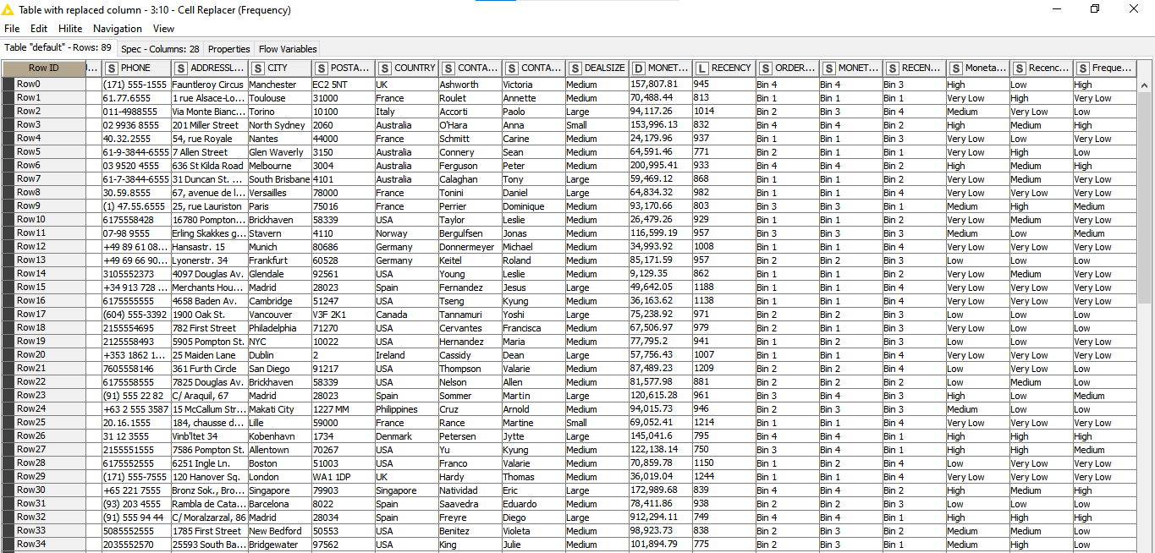
Customer Segmentation using RFM analysis (make 4 segments)
Output table head

Slide 17
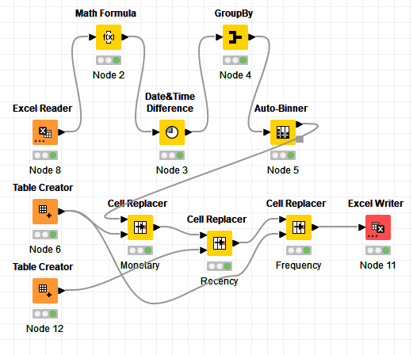
Customer Segmentation using RFM analysis (make 4 segments)
When KNIME used, Workflow image :-

Slide 18
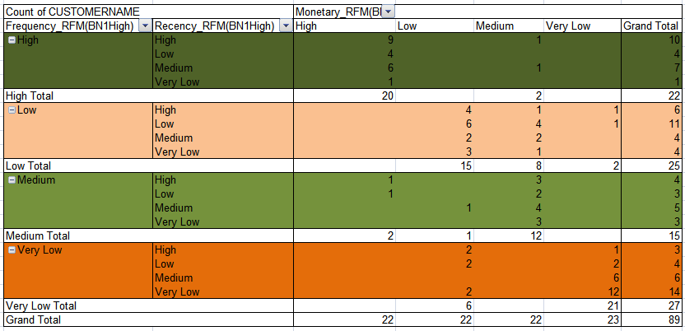
Inferences from RFM Analysis and identified segments
3 BY 3 RFM Matrix:-
Active
AT -Risk
Neutral or less Active
In-active or Lost

Slide 19


Slide 20
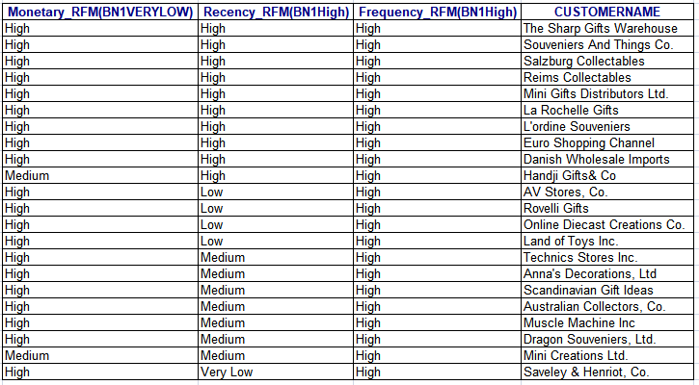
Inferences from RFM Analysis and identified segments
Who are your best customers?
Found Active customers 24.7191%.
After performing RFM analysis, it was found that gold members consists of top 10.11236% of total customer.

Slide 21
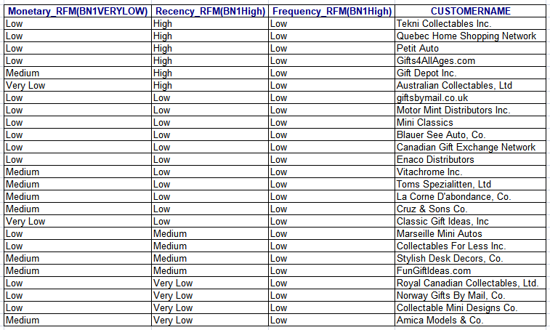
Inferences from RFM Analysis and identified segments
Which customers are on the verge of churning?
28.08989% is on the verge of churning.

Slide 22
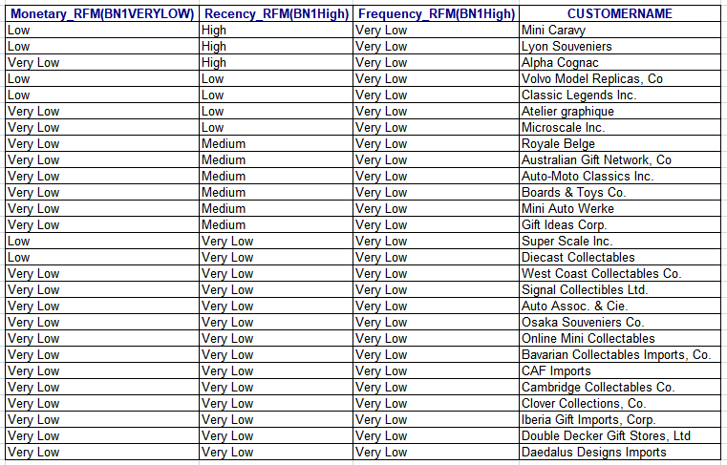
Inferences from RFM Analysis and identified segments
Who are your lost customers?
If there is no such cost justification to allocate these customers then we can ruthlessly cut-off these in-active or lost customers.

Slide 23
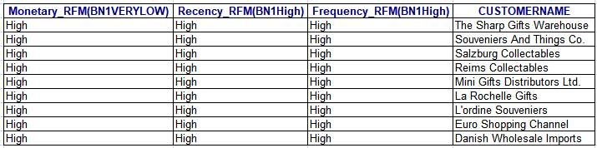
Inferences from RFM Analysis and identified segments
Who are your loyal customers?
After performing RFM analysis, it was found that gold members consists of top 10.11236% of total customer.
These are the top 9 loyal customers having high monetary value , high frequency and high recency .

Slide 24
A FEW REFERENCES(TABLEAU REFERENCES)
https://public.tableau.com/app/profile/shounack/viz/MRA_Analysis_shounack/BIVARIATESALES
https://public.tableau.com/app/profile/shounack/viz/MRA_Analysis_shounack01/SalesCOUNTRY?publish=yes
https://public.tableau.com/app/profile/shounack/viz/MRA_Analysis_shounack02/ALLTIMELINEANDSALES?publish=yes
https://public.tableau.com/app/profile/shounack/viz/MRA_WORLDMAP/Sheet1?publish=yes

Slide 25
THE END

